Slide 1
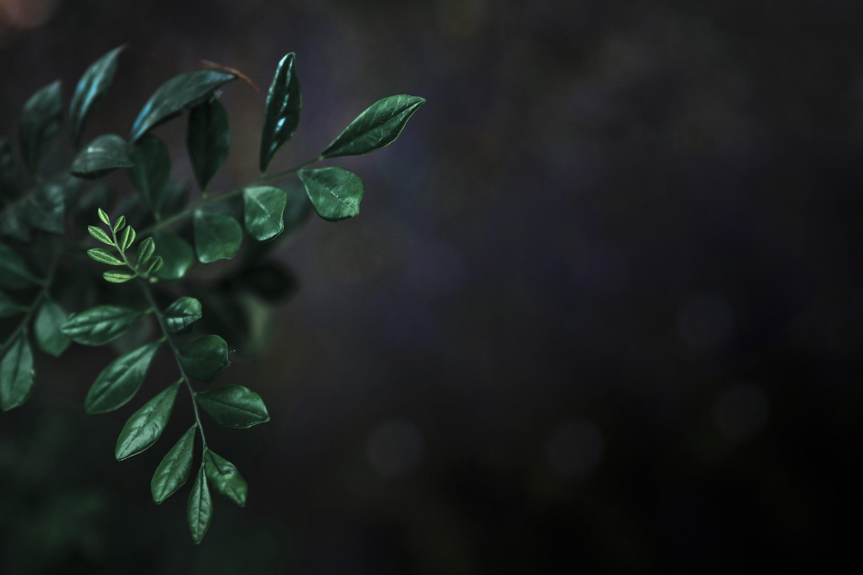
The Smart Gardner
Group 27
Green Core
Notes:
Good Morning everyone, we are group no 27. Our project is Green Core - the smart gardner.

Slide 2
Team
G27
Group Members:
M.M.H Tharushika
H.U.K.M Pabasara
J.A.N.C Niroshana
B.A Medawatta
K.C Gamage
K.S.A Ahamed
17001765
17020611
17001196
17001072
17000475
17020034
Supervisor
Dr Dinuni K Fernando
Co-Supervisor
Miss. Sithara Fernando
Notes:
Our group supervisor is Dr. Dinuni K Fernando and Miss. Sithara Fernando is our co supervisor.
And Hashini, Minura, Nipuna, Binara, Kaviska and I Aathil are our group members.

Slide 3

Green Core - The Smart Gardner
G27
Outline
Introduction
Problem Definition
Goal and Objectives
Functional Requirements
Quality Attributes
Feedback and Solutions
High Level System Architecture
Technologies
Member Contribution
Notes:
I’ll present about Introduction and problem definition part.

Slide 4
Problem Definition
G27
People tend to stay at home leisurely for limited time Due to their busy lifestyles.
Gardening with minimum effort is worth and effective.
With the pandemic which occurred in recent past, people tend to grow their own produce for sustainability.
But after this situation people may not have time to take care of their plants due to their busy lifestyle.
Notes:
according to the survey we did among about 160 people,[move to next slide]

Slide 5
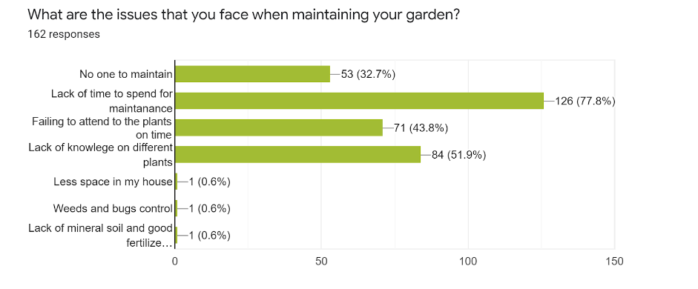
Results of the survey
G27
Notes:
The majority of the people responded that they don’t have that much time for gardening and maintaining the things, and another response was failing to attend to the plants on the time that’s mean due to their busy lifestyle it is very hard to concentrate on the plants. [Move to next slide ]

Slide 6
Problem Definition
G27
People tend to stay at home leisurely for limited time Due to their busy lifestyles.
Gardening with minimum effort is worth and effective.
With the pandemic which occurred in recent past, people tend to grow their own produce for sustainability.
But after this situation people may not have time to take care of their plants due to their busy lifestyle.
Notes:
Usually people tend to stay at home for limited time, due to their busy lifestyle and working schedules. But the pandemic which occured in the recent past, people tend to gardening by themselves for sustainability .
Gardening with minimum effort is worth it.
But after this pandemic, the situation will be totally changed and people may not have time to take care of their gardens as the situations before the pandemic.
We hope “Green Core - The smart gardener” our project will be the suitable solution in these kinds of situations and will be needed.

Slide 7
Introduction
G27
Green-Core is an automated gardening system consists of both manual and automatic gardening features.
Enable users to control their garden while they are away from home by using a smartphone.
Capable of real gardening features such as watering plants.
System consists of an IoT device and a mobile app for the user and a web app to control inner settings.
Notes:
Green core is an automated gardening system.
it consists of both
manual and
2) automatic gardening features,
where Green core enables users of the systems to control the garden it doesn’t matter wherever they are.
And also the system is capable of real gardening features such as
watering plants,
adding fertilizers,
considering growing lights.
Our system consists of IoT device and mobile app for the users.
And a web app for controlling inner settings like admin controls.
from here onwards Kavishka will continue[Move to next slide ]

Slide 8

Goal and objectives
G27
Notes:
Thank you Athil. Now let’s talk about Goal and objectives.[Move to next slide ]

Slide 9
Our Goal
G27
Our main goal is to develop a smart garden environment that allows the user to provide a periodic gardening experience via a mobile phone.
Notes:
To make our project a success we need a clear goal.
Our main goal is to develop a smart garden environment that allows the user to provide a periodic gardening experience via a mobile phone.
Green core - the smart gardener will provide you with a new gardening experience that you never had before.
[Move to next slide ]

Slide 10
Objectives
G27
People can get fresh vegetables and fruits from their garden with aid of a Mobile App.
Track the progress of each IoT sensor unit’s status.
Adjust the growing environment remotely and automatically manage the garden lively.
Get periodic notifications of individual IoT sensor unit’s status via Mobile App.
Administrator can collect, view data of all gardens via Web App and use them for identifying vulnerable units etc.
Notes:
To achieve our goal we have identify our objectives as…
1.People can get fresh vegetables and fruits from their garden with aid of a mobile app.
2.User can Track the progress of each iot sensor unit’s status and get periodic notifications
3 . user can adjust the growing environment remotely and they can automatically manage the garden lively
4. Get periodic notifications of each unit status via mobile App.
5. with our web app administrator can collect and view data of all the gardens and use them for identifying vulnerable units.
from here onwards hasini will continue the presentation [Move to next slide ]

Slide 11
Functional Requirements
G27
Notes:
Thank you Kavishka, Functional Requirements [Move to next slide ]

Slide 12
Functional Requirements of the Mobile App
G27
User can sign up and log into the mobile App and setup account settings.
App is able to get feedback of IoT sensor units (Humidity sensor,Light intensity sensor,servo motors,water level sensor and soil moisture sensor).
Periodic notifications regarding status of the user’s garden.
User can monitor the garden status (water level,nutrition level and light intensity).
User can add new units/modules
Users can contact administrators using the inbuilt chat module .
Notes:
We have identify functional requirements of our mobile App as…..
User can sign up and log into the mobile App and setup account settings.
App is able to get feedback of iot sensor units .Some of the sensors we are using are Humidity sensor,Light intensity sensor,servo motors,water level sensor and soil moisture sensor .
Periodic notifications regarding status of the user’s garden.
User can monitor the garden status like water level,nutrition level and light intensity.
User can add new units or modules.
And also users can contact administrators using the inbuilt chat.
[Move to next slide ]

Slide 13
Functional Requirements of the Web App
G27
User(admin) can sign up and log in.
User can update profile details.
View analyzed data(graphs) about gardens.
View a district wise local map of all the mobile app users garden location.
Notify about failed or vulnerable sensor units.
Contact users regarding their issues and issues with their IOT devices(Chat Module).
Notes:
Here are the functional requirements in our web App
User,all admins can sign up and log in.
User can update their profile details.
View analyzed data(graphs) about gardens.
View a district wise local map of all the mobile app users garden location.
Notify about failed or vulnerable units.
Contact users regarding their issues and issues with their IoT devices thorough Chat Module in the web App.
[Move to next slide ]

Slide 14
Functional Requirements of the IoT Device
G27
Plant watering system - manual & automatic
Bug detection system - automatic
Plant fertilization system - manual
Light intensity control - manual & automatic
Sensor data gathering (temperature, humidity, light intensity, soil moisture)
Notes:
Here are the functional requirements in our IoT Device
Plant Watering System. we can do it either manually or automatically
Automatic Bug detection system
manual Plant Fertilization system
Light intensity Control. this is alco can do either manually or automatically.
Sensor data gathering like temperature, humidity, light intensity, soil moisture.
from here onwards Minura will continue the presentation.[Move to next slide ]

Slide 15
Quality attributes
G27
Notes:
Now we will consider about the quality attributes.[Move to next slide ]

Slide 16

G27
Availability
System will be available on both mobile and web with any internet accessible device.
Usability
Simple and easy to use interface throughout the mobile and web App.
Dependability
Backups backend database to a database in the cloud
periodically.
Notes:
Availability
after the system is deployed for use, it will be available on any internet accessible device. It can be accessed web application for admins and mobile application for the users.
Usability
the user interfaces on both the web application and the mobile app are simple and easy to use. So even new users can use them without any issue.
Dependability
the data in our database is periodically backed up to a cloud database. We are hoping to use aws for this purpose

Slide 17
G27
Security
Only administrators can access the web app
Only registered users can enter to the mobile app.
Assumption- Administrator is a trustworthy person.
Maintainability
Mobile app can be updated easily through Playstore.
Repairs on the IoT device can be done easily because of the modular nature of the IOT device.
Notes:
Security
Security is highly maintained as only the admins can access the web app.
In here, we are assuming that admins are trustworthy individuals. And also only registered users have access to the mobile app
Maintainability
through Playstore Mobile app can be updated easily.
Most importantly, the ioT device can easily be repaired because of the modular nature of the IOT device.
from here onwards Binara will continue the presentation.

Slide 18
Feedback and Solutions
G27
Notes:
Thank you Minura
Feedback and Solutions [Move to next slide ]

Slide 19
G27
IoT device to do workload is greater than completed workload
Focused about IoT device and gave more priority to related functionalities.
Web Application incompleteness
Add styles and color to web application.
Make style consistent and attractive.
Complete the navigation flaw of web application.
NodeMCU & Arduino Mega serial communication connection is not established
Study more on serial communication.
Notes:
In the interim presentation the we were advised to focus more on the IoT device, so we gave more priority to its functionalities
THey pointed out that the web application is incomplete, and the styles were not present in it, so we worked on it and and completed the web app
At that time the connection between the arduino mega and the nodemcu were not established, because we didn’t have the knowledge required for it, but after the presentation we studied it and finished the serial communication.
from here onwards Nipuna will continue the presentation.

Slide 20
High Level System Architecture
G27
Notes:
Thank you Binara. Next we’ll move into the High level system Architecture[Move to next slide ]

Slide 21
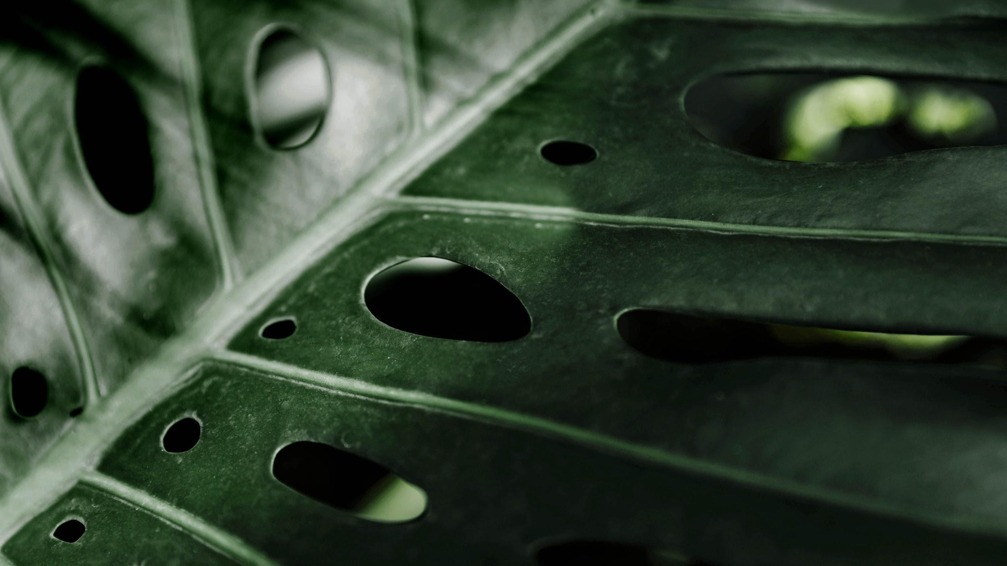


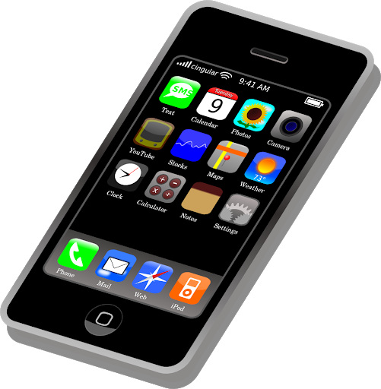
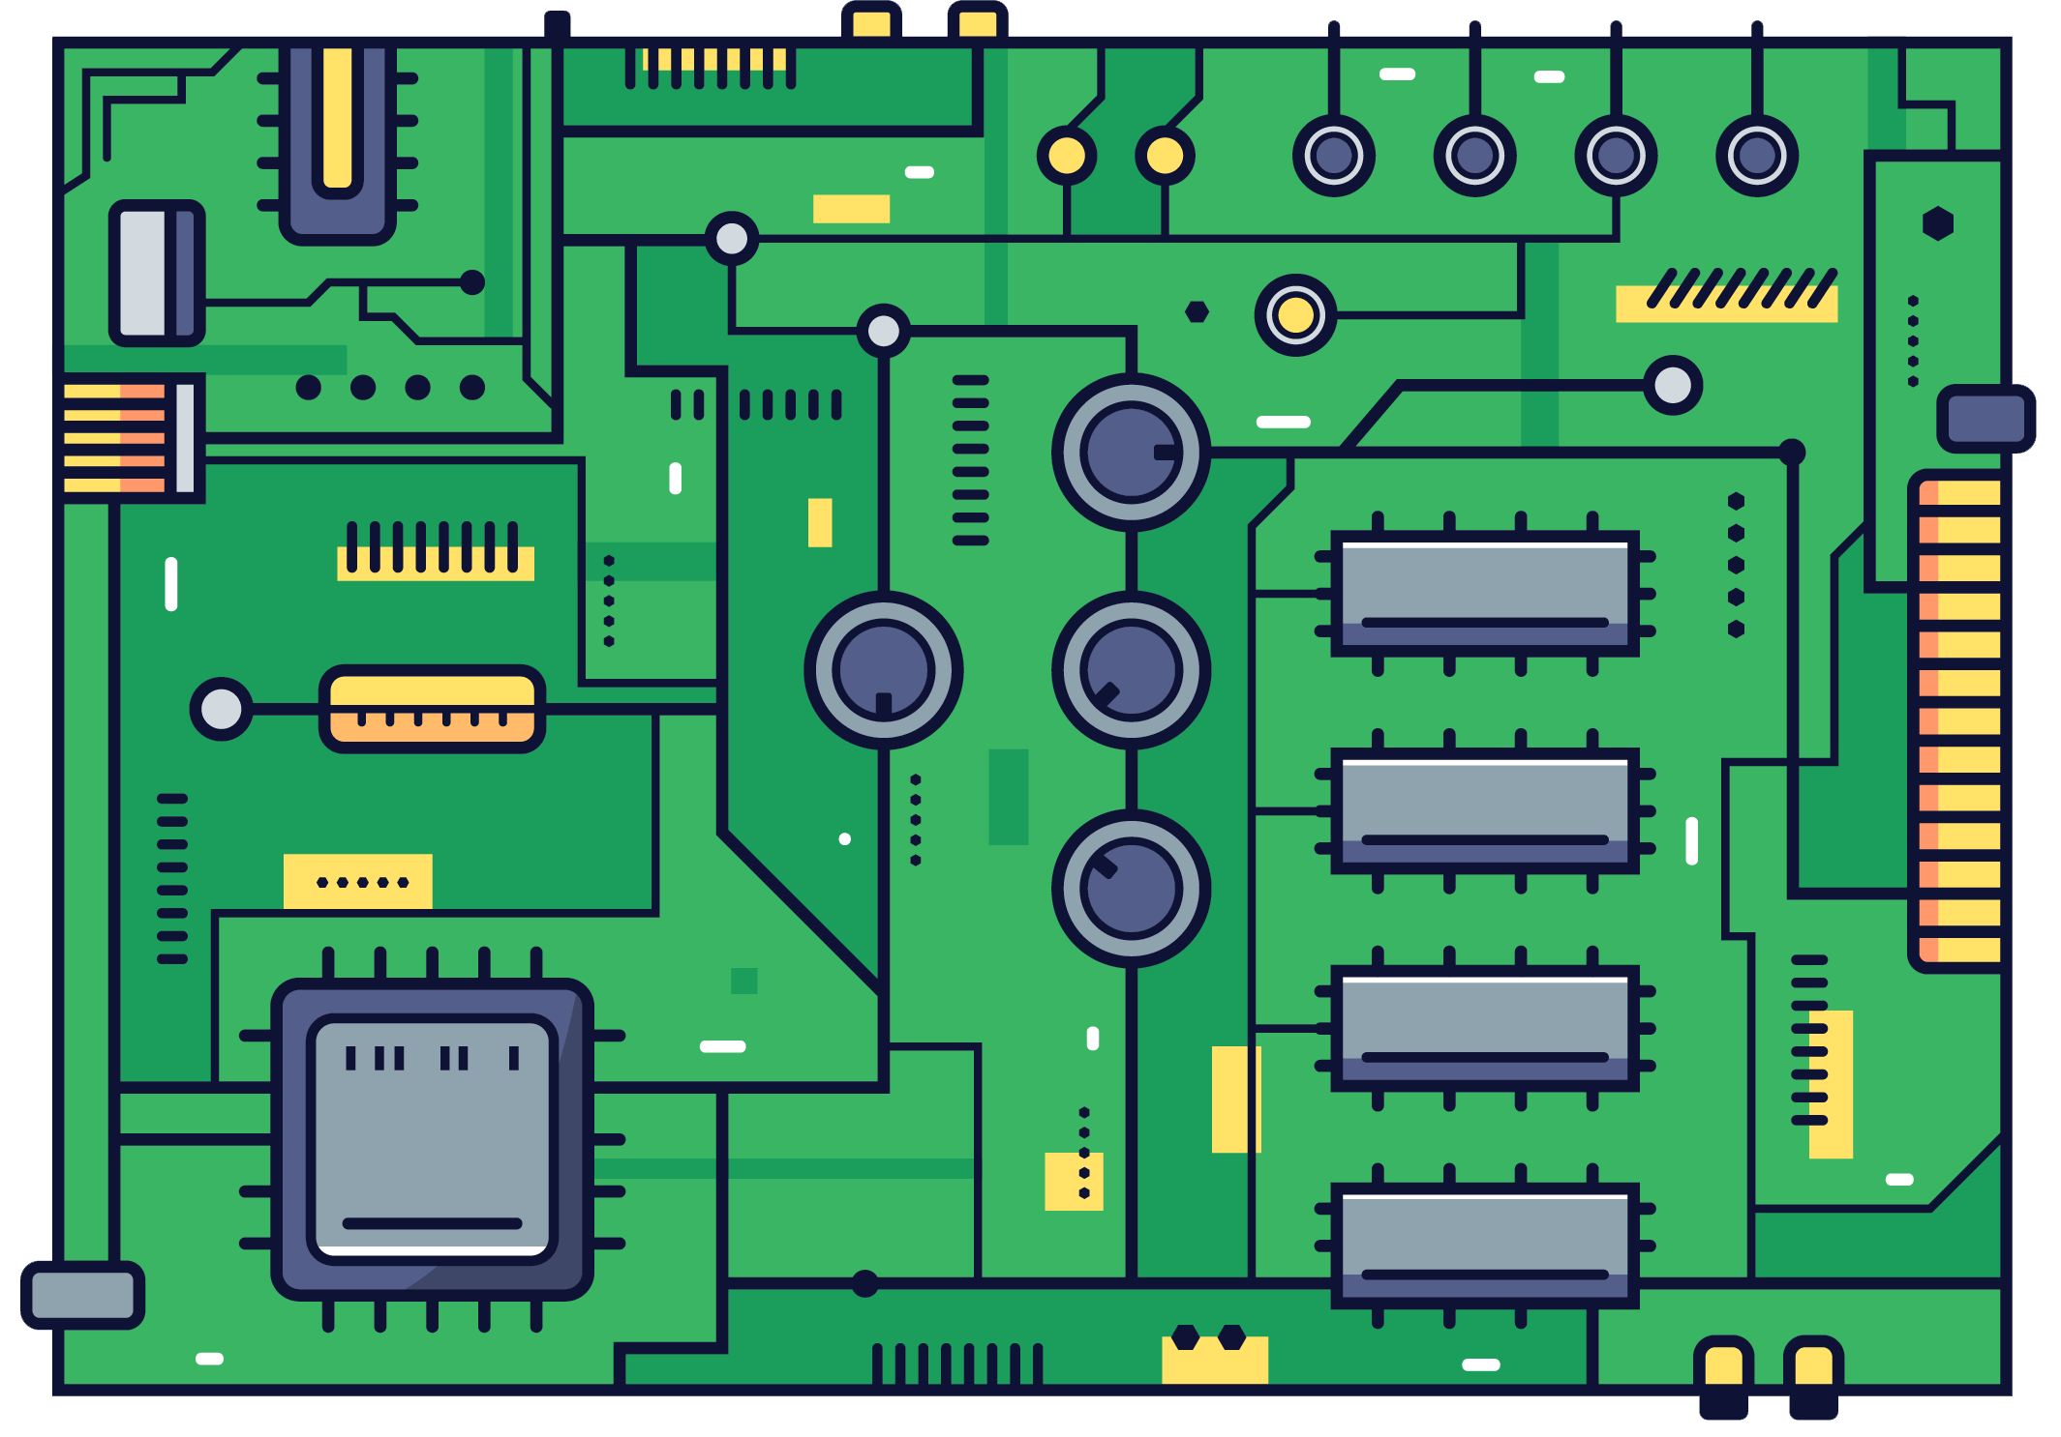
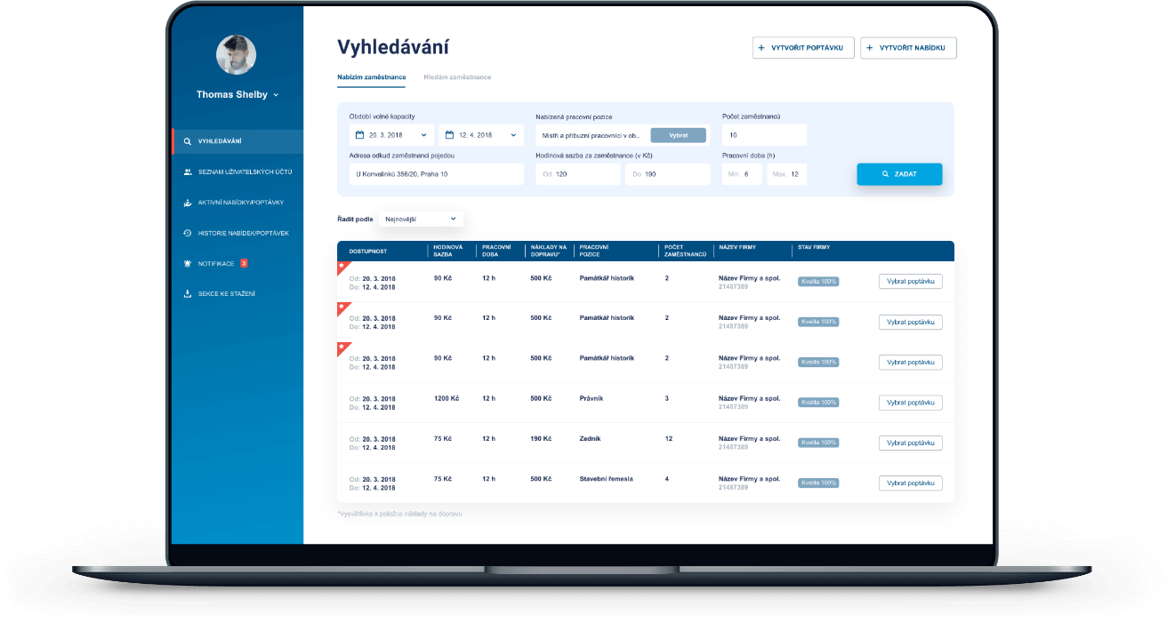
G27
Database
Web server
Web server
Web server
IoT device
Web app
Mobile app
Notes:
Our system consists of a central database which the mobile app, web app and the iot device will be connected using independent servers.
.[Move to next slide ]
Communication between the apps, devices and the servers are done VIA API calls.
The IoT Device will collect data from the sensors and pass it to the database. The web app and the mobile app can retrieve data from the database. All the functions carried out by the
user with the IoT device will be first updated in the database and then the action will be carried out in the IoT device

Slide 22
Technologies
G27
Notes:
Next we’ll move into technologies [Move to next slide ]

Slide 23
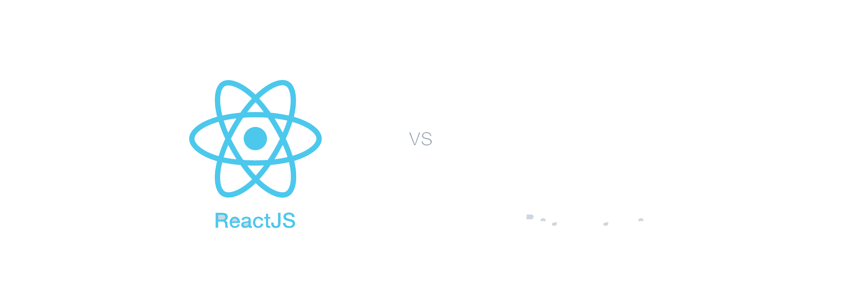
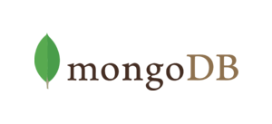

Mobile App & Web App
Front End
Back End
React JS
MongoDB
React native
NodeJS
Notes:
We use ReactJS for the front end of the web app and react native for the mobile app. As the backend server, we are using nodejs and MongoDB as our database
[Move to next slide ]

Slide 24
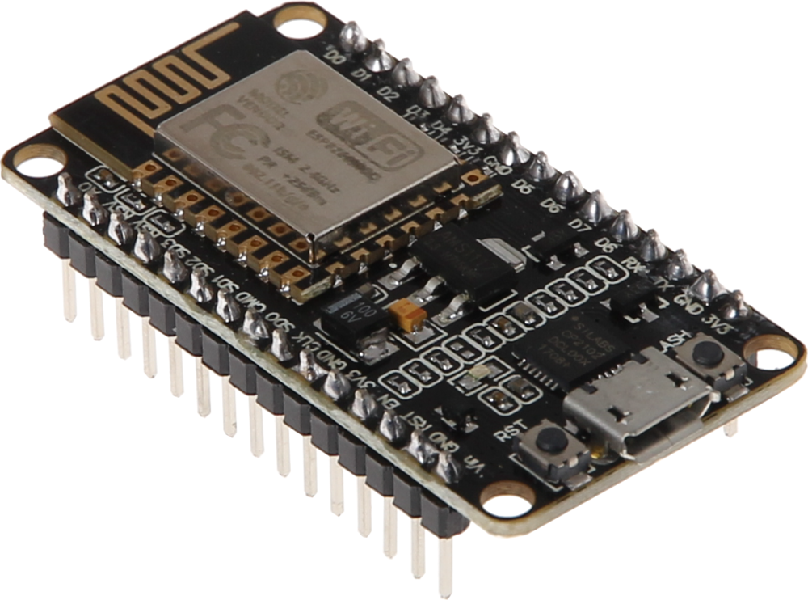
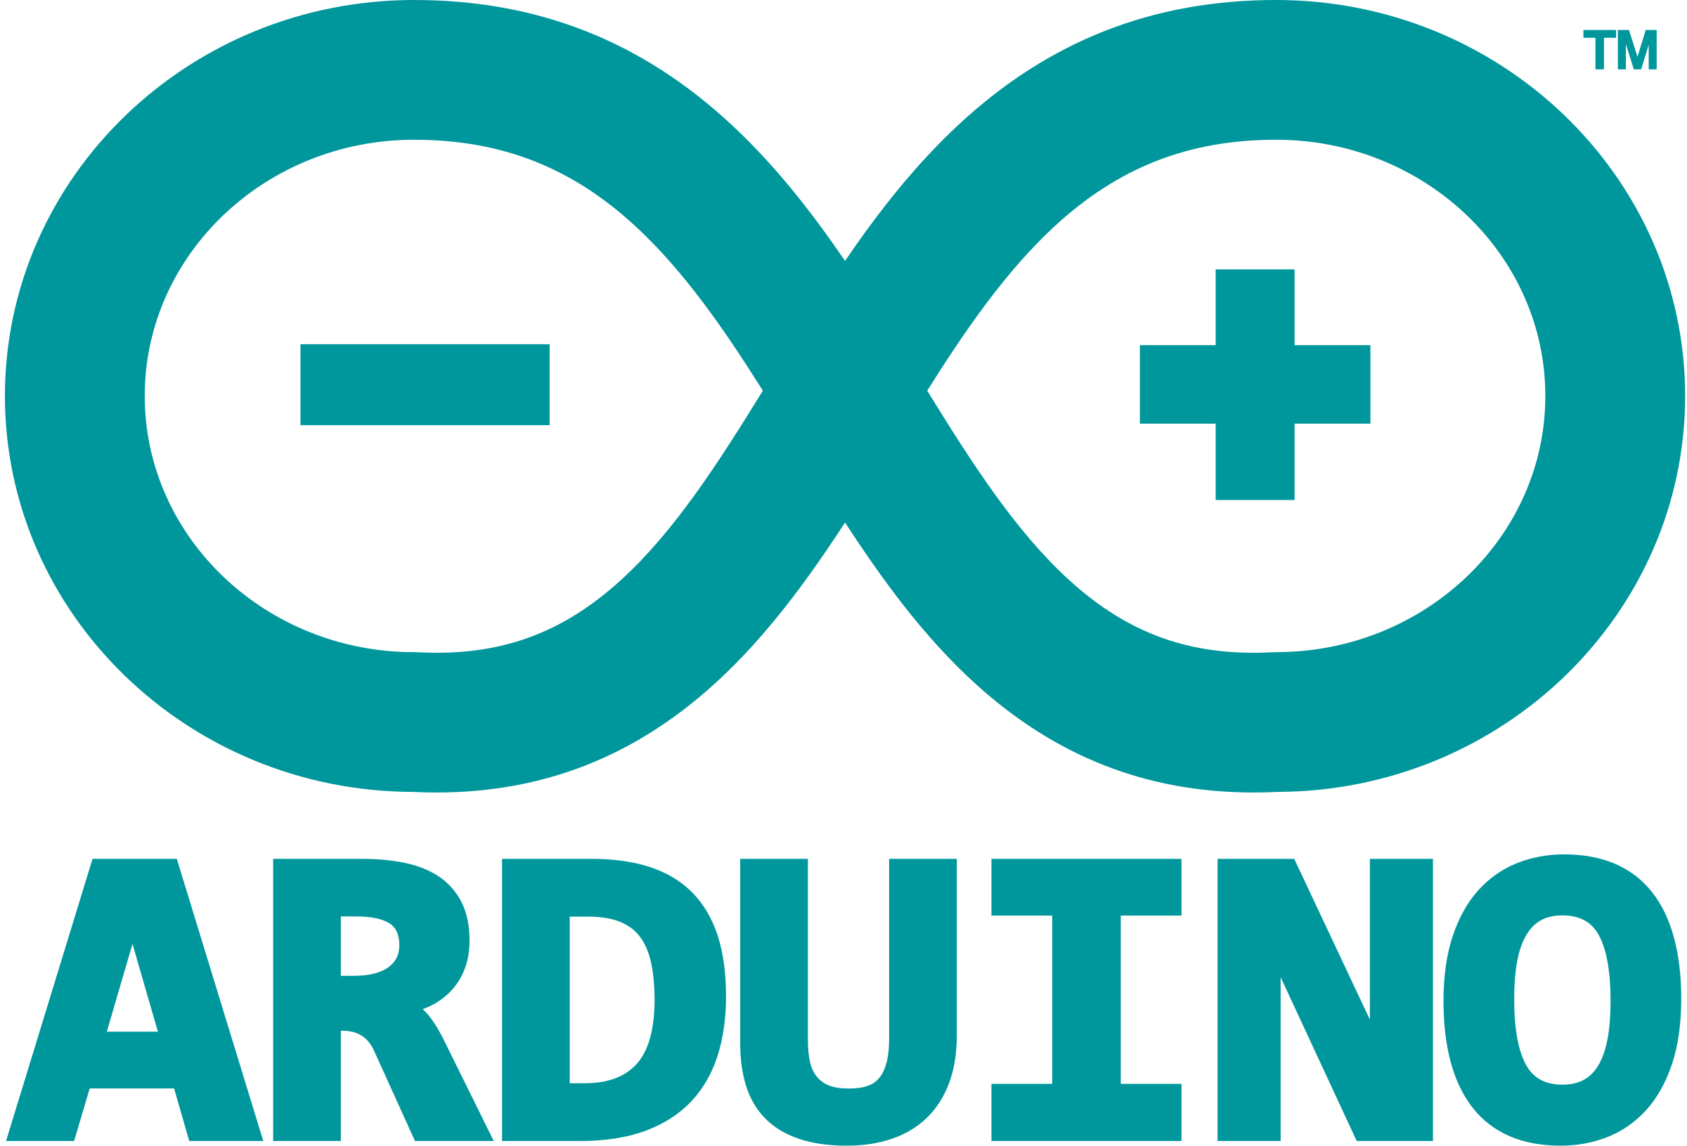
IoT device
Device
Back End
Node MCU
MongoDB
Arduino mega
NodeJS
Notes:
For the IoT Device, we use Arduino to collect sensor data and to control actuators
and a NodeMCU for communication.
For the backend development of the IoT Device, we use Node.js as the server and MongoDB as the database[Move to next slide ]

Slide 25
Member Contribution
G27
Notes:
Thanks Nipuna, Let’s look about Members’ contributions. All the 6 members contributed to the project in both development and documentation.

Slide 26
K.S.A Ahamed - 17020034 | Web App View all and single units View all users View Single user details UI Designs SRS Presentations
Notes:
I am Aathil,
I worked in units module and user module on web application in. as well as I worked on user interface designing works.
Through this project I could gain knowledge in totally new technologies like React, MongoDB as well as remote development also one of the best experience I could gained.

Slide 27
G27
K.C Gamage - 17000475 | Mobile App Splash Screen Log in and Log out Secure Mobile App all Rest API requests with JWT tokens Sign up Mobile App Navigation Email Verification Forgot Password Web App View All plants Plant tips
Notes:
I am Kavishka I worked on the login/log out with forgot password functionalities, registration with email verification functionalities and navigation of the mobile app.
And I worked on plant view and plant tips on the web app. I learned about mobile development using react native and It was a new experience to me. I Gained more experience with react,node and mongoDB technologies.

Slide 28
G27
M.M.H Tharushika - 17001765 | Web App User Registration User Login Forgot Password Reset Password SRS Presentations
Notes:
I’m Hasini. I worked on the User registration, user login, Forgot password and Reset password on the web application.
Through this project i learned react as a new technology and gained a good experience on nodejs and mongodb.
Also I worked on documentations and feasibility of the project as well.

Slide 29
H.U.K.M Pabasara - 17020611 | Web App View all Vulnerable Units View admin details View all admins View Single admin UI Designs SRS Presentations
Notes:
I’m Minura. I worked on Vulnerable units module, Admin module and UI designs of the web Application.
Through this project I gained lots of knowledge about technologies React JS and Mongodb which i learned for the first time.
I focused on project documentation and feasibility as well

Slide 30
G27
B.A Medawatta - 17001072 | IoT Device Sensor detection & Control Backend Chat Module - Mobile App Send Message Reply Message View All Messages View Single Message Chat Module - Web App View All Messages View Single Message Reply Message View Unread Messages Dashboard - Web App Navigation - Web App
Notes:
I’m Binara Medawatta and I worked on the,
Chat module of the Web app and the mobile app,
Dashboard and Navigation of the web app
sensor detection, control and the backend of the IoT Device
Throughout the project I learned some new technologies like react and react native, also I got the chance to brush up my in Arduino and team working skills. And Remote working was a whole new experience

Slide 31
J.A.N.C Niroshana - 17001196 | Mobile App Account settings Profile settings Link units Linked units Unit details Notifications Planting tips Unit details Actions User manual
Notes:
I’m Nipuna ,
I worked on Unit management,
Planting tips
Notifications
Account and profile settings and
User manual of the mobile app
Throughout the project I learned some new technologies like react native , NodeJS and MongoDB

Slide 32

Demonstration
G27
Notes:
let’s move on to the demonstration

Slide 33
Thank You
G27
Notes:
Thank you

Slide 34
Any Questions ?
G27
Notes:
Thank you, we are happy to take any questions.

